Slide 1
SANZIE HEALTHCARE SERVICES, INC.
TRAINING
SEIZURE PRECAUTIONS

Slide 2
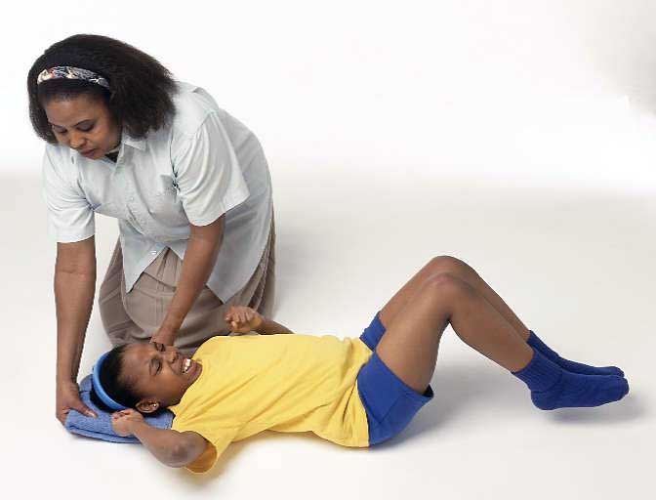
What is a seizure?
A seizure is a sudden surge of electrical activity in the brain that usually affects how a person feels or acts for a short time.

Slide 3
Seizures
There are two types of seizures
1. Grand mal seizure
2. Petit mal seizure

Slide 4
Petit mal Seizure
A petit mal seizure is the name given to a staring spell. It last for a maximum of 15 seconds and is caused by disturbance of brain function due to abnormal electrical activity in the brain.

Slide 5
Grand Mal
          A grand mal seizure involves a loss of consciousness and violent muscle contractions. It's the type of seizure most people picture when they think about seizures in general.

Slide 6
Grand Mal Seizure
Today we are going to look at seizure precautions regarding grand mal seizures.

Slide 7
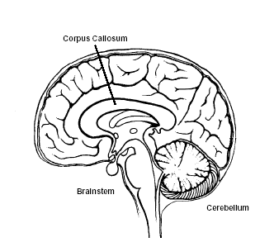
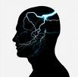
Grand Mal Seizure
Grand mal seizure is caused by abnormal electrical activity throughout the brain.

Slide 8
Grand mal seizure
In some cases, this type of seizure is triggered by other health problems, such as extremely low blood sugar or a stroke.

Slide 9
Grand Mal Seizure
In most cases a grand mal seizure is triggered by epilepsy.

Slide 10
Grand Mal Seizure
A grand mal seizure has two stages.
Stage 1: Tonic Phase
Stage 2: Clonic Phase

Slide 11
Grand Mal Seizure
Tonic phase - Loss of consciousness occurs, and the muscles suddenly contract and cause the person to fall down. This phase tends to last about 10 to 20 seconds.

Slide 12
Grand Mal Seizure
Clonic phase -The muscles go into rhythmic contractions, alternately flexing and relaxing. Convulsions usually last for less than two minutes.

Slide 13
Grand Mal Seizure
Other symptoms may occur such as:
Aura - Some people experience a warning feeling (aura) before a grand mal seizure. This warning varies from person to person, but may include feeling a sense of unexplained dread, a strange smell or a feeling of numbness.

Slide 14
Grand Mal Seizure
A scream - Some people may cry out at the beginning of a seizure because the muscles around the vocal cords seize, forcing air out.

Slide 15
Grand Mal Seizure
Loss of bowel and bladder control - This may happen during or following a seizure.

Slide 16
Grand Mal Seizure
Unresponsiveness after convulsions -Unconsciousness may persist for several minutes after the convulsion has ended.

Slide 17
Grand Mal Seizure
Confusion - A period of disorientation often follows a grand mal seizure. This is referred to as postictal confusion.

Slide 18
Grand Mal Seizure
Fatigue - Sleepiness is common after a grand mal seizure

Slide 19
Grand Mal Seizure
Severe headache - Headaches are common but not universal after grand mal seizures.

Slide 20
Grand Mal Seizure
WHAT TO DO?

Slide 21
Grand Mal Seizure
REMAIN CALM!

Slide 22
Grand Mal Seizure
WHAT TO DO
Gently roll the person onto one side and put something soft under his or her head.

Slide 23
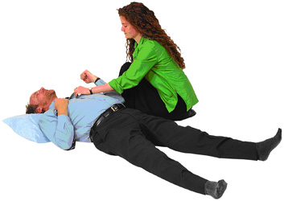
Grand Mal Seizure
WHAT TO DO
Loosen tight neckwear.

Slide 24
Grand Mal Seizure
WHAT TO DO
Clear a space around the person, moving away objects that could be harmful.

Slide 25
Grand Mal Seizure
WHAT NOT TO DO
Do not put anything in the mouth — the tongue can't be swallowed and objects placed in the mouth can be bitten or inhaled.

Slide 26
Grand Mal Seizure
WHAT NOT TO DO
Do not try to restrain the person.
Allow the seizure to run its course.

Slide 27
Grand Mal Seizure
YOU NEED TO CALL 911 WHEN:
The seizure lasts longer than five minutes
The seizure lasts longer than is usual for the person involved
The person has a series of seizures without regaining consciousness in between
The person has received injuries during the seizure.

Slide 28
Grand Mal Seizure
AFTER THE SEIZURE
Allow the individual to rest to recover from the seizure.

Slide 29
Grand Mal Seizure
Encourage the individual with seizure to lead a normal life, but take some precautions.
DO NOT allow the individual to swim unsupervised.
Check on the individual while the individual is in the shower.
Check on the individual while he is sleeping.
If the individual is going to ride a bicycle, make sure he wears a helmet.

Slide 30
Grand Mal Seizure
QUICK NOTES
STAY CALM !!!
MOST SEIZURES LASTS ONLY A FEW MINUTES

Slide 31
Grand Mal Seizure
PREVENT INJURY BY MOVING NEARBY OBJECTS OUT THE WAY

Slide 32
Grand Mal Seizure
PAY ATTENTION TO THE LENGTH OF THE SEIZURE.
YOU NEED TO DOCUMENT THIS INFORMATION.

Slide 33
Grand Mal Seizure
DO NOT HOLD THE PERSON DOWN.
ALLOW THE SEIZURE TO RUN ITS COURSE

Slide 34
Grand Mal Seizure
IF THE SEIZURES CONTINUES FOR MORE THAN 5 MINUTES, CALL 911.

Slide 35
Grand Mal Seizure
DO NOT PUT ANYTHNG IN THE PERSON’S MOUTH.

Slide 36
Grand Mal Seizure
BE SENSITIVE AND SUPPORTIVE.

Slide 37
Grand Mal Seizure
QUESTIONS AND ANSWERS

Slide 38
Grand Mal Seizure
Hope of Columbus, Inc.

